Slide 1
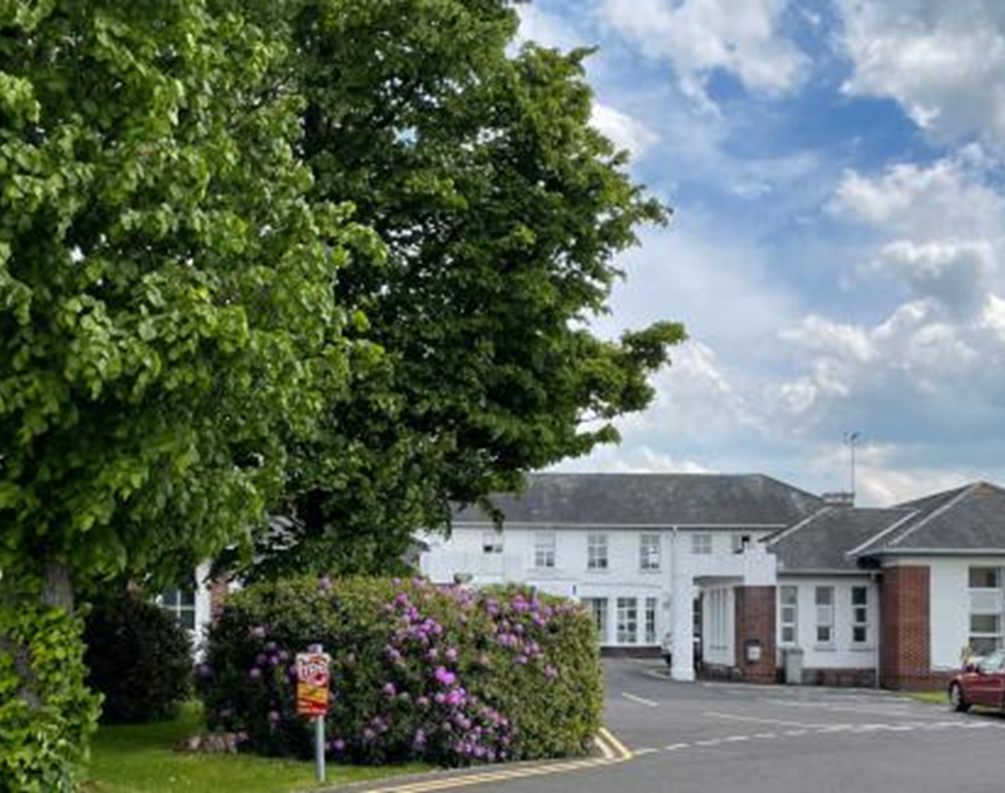
Creating an Open Door in Communication during Covid-19
Dr Shauna Fannin
Clinical Lead GP
Robinson Memorial Hospital
Ballymoney Co. Antrim
N. Ireland

Slide 2
Talk Outline
The Robinson Hospital Prior To Covid-19
1
2
Patients And Families - What Did We Do?
Communication & Challenges
3
4
Learning, Sustainability and Outcomes

Slide 3
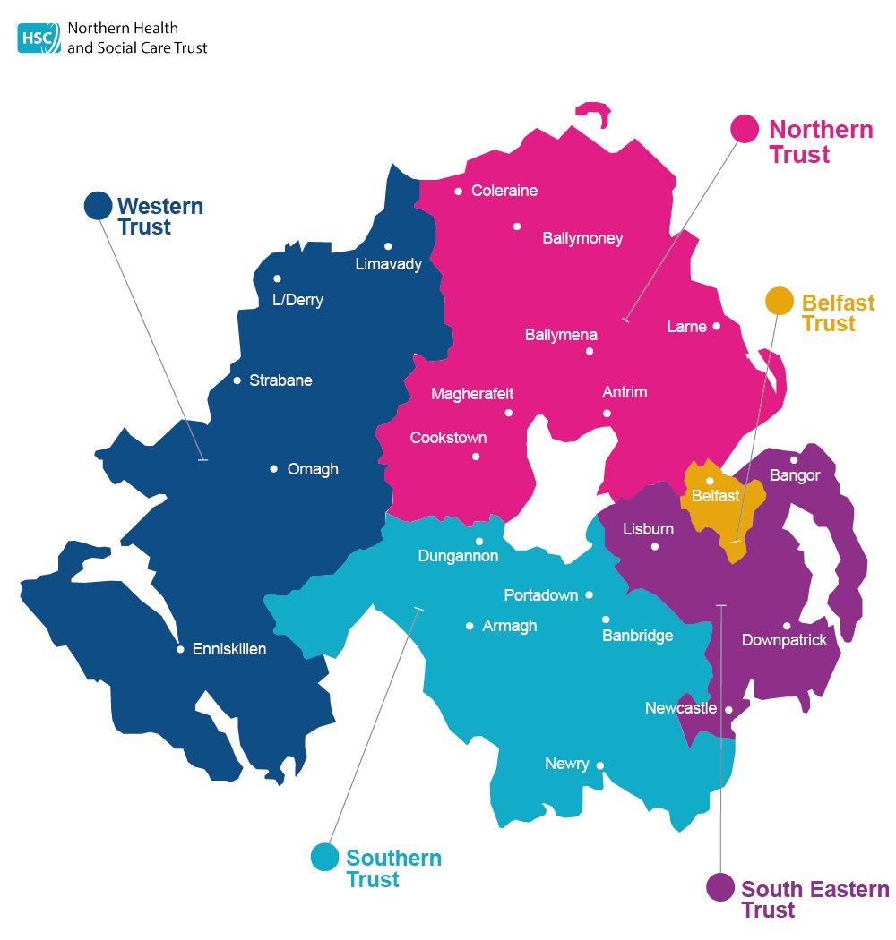
Background
NHSCT serves a pop. of 480,000 and covers 1733 sq miles
4 CH sites
Long standing Community Hospital (1933)
16 bedded unit
Focus on rehabilitation, generalist palliative care
Frailty project

Slide 4
Frailty Project
Big Room methodology, weekly meetings
Establish better ways to identify and manage patients with frailty
Championed End PJ Paralysis, John’s Campaign
Engagement of family members in patient’s therapy sessions
Leading to:
Better family understanding of patient’s progress and rehabilitation goals
Proactive communication with families and shared decision making
Strong multi-disciplinary team who knew each other well

Slide 5

Covid-19 strikes
Designated as a Covid-19 unit:
Provide care for patients not requiring or unfit for more intensive treatment
Accept patients from a wide geographical area across NHSCT
Early focus on learning by all staff
Early understanding that communication, with families in particular, would be important!
‘Winter is coming’

Slide 6

WHAT CAN I SAY?

Slide 7
Remembering…
‘Patients (and families) value qualities such as caring, trust, feeling known, acknowledged and connected more than specific communication techniques’
National Cancer Institute, 2007

Slide 8
Good Communication
TRUST
Helps people adjust & plan
UNCERTAINTY
UNREALISTIC EXPECTATIONS
Leaves a lasting impact
CONSPIRACY OF SILENCE

Slide 9
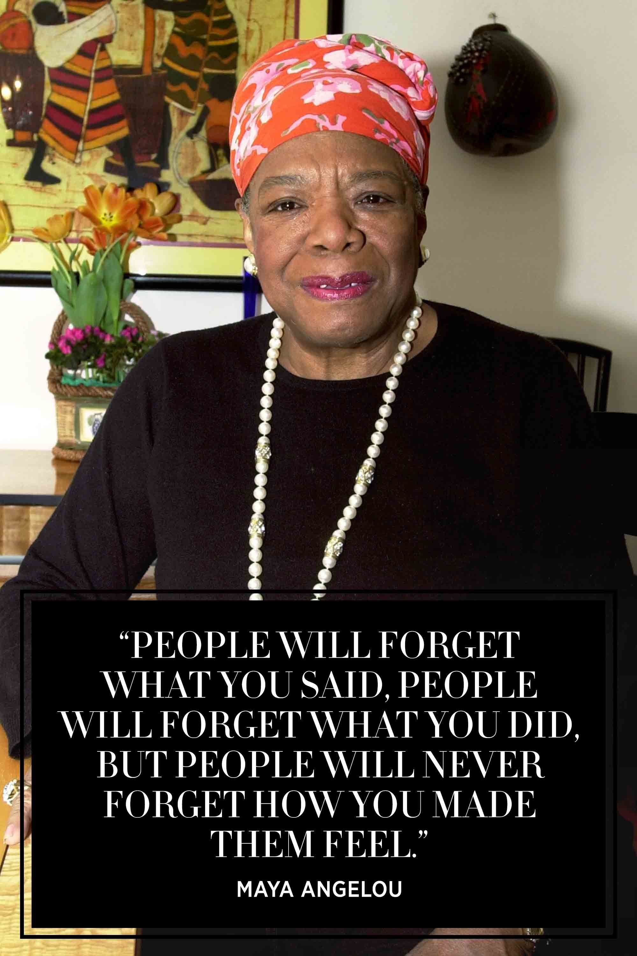

Slide 10
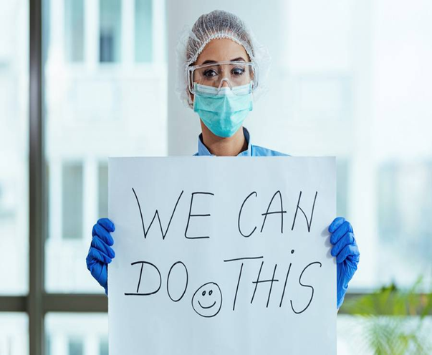
What Could We Do For Our Patients
We needed:
To cope with our own fears and uncertainty
To “fill the gaps”
Cope with increased distress of patients and their families
Increase the intensity of contacts with patients
Hold a patient’s hands-it became more essential
Get Talking!

Slide 11

“Get Talking”
“Research has shown that when people are seriously ill, one of their biggest problems is that people won’t talk to them and feeling isolated makes them feel worse.”
Macmillan ‘Talking To Someone’ booklet

Slide 12
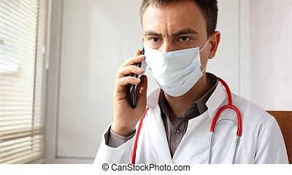
What We Did For Families
They were not able to be part of their loved one’s face to face care so:
Clear proactive communication on a daily basis
Inform them of their loved one’s clinical condition, frequently if deteriorating
Reassure that loved one would not be left alone when dying
BUILD A BOND OF TRUST WITH THE FAMILY

Slide 13

Communication Impact
In Person
TONE
38%
NON VERBAL
55%
WORDS
7%
Mehrabian, A. 1972

Slide 14


Communication Impact
TONE
86%
On the phone
WORDS
14%
Mehrabian, A. 1972

Slide 15
The “Wish, Worry, Wonder” Framework
Key ideas:
I WISH allows for aligning with the family member’s hopes
I WORRY allows for being truthful while sensitive
I WONDER is a subtle way to make a recommendation
Try This Strategy:
“I wish your Dad was showing signs of improvement and I promise we will give him the best care possible. But I worry you will not be prepared if things don’t go as we hope. I wonder can we discuss what might happen if his condition would deteriorate.”

Slide 16
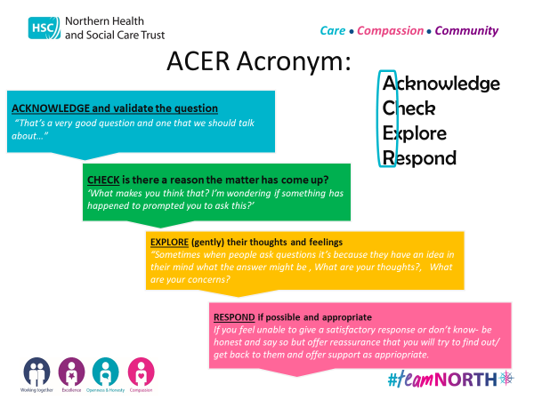

Slide 17
Challenges
Family members often confused, frightened, angry, looking for simple answers to complex questions
Become comfortable with uncertainty and the idea that saying “ I don’t know” was okay
Avoid medical jargon. Ask person “ Does that make sense?”
Be brief but clear. Long answers risk being confusing and covering too much ground. Give the person time to reflect and respond to each point independently
Learn from others and give + feedback “ I liked the way you spoke to Mrs X and the words you used.”

Slide 18
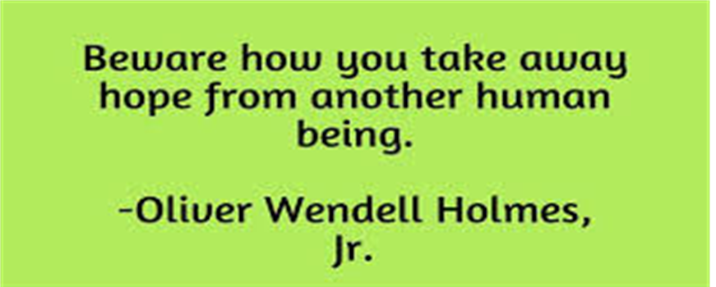
“Hope” is the thing with feathers-
That perches in the soul ( Emily Dickinson)
Never give false hope but never take all other hope away

Slide 19
End of Life Care
When a patient was dying
Conversations with family had to be direct but compassionate
Often had to happen over the phone or Ipad which sometimes felt brutal
Conversations were more intense with a lack of the usual non-verbal feedback

Slide 20
Communication with colleagues
Improved communication with medical colleagues and teams
  Appropriate referrals
  Ceilings of care/escalation
  Prior communication with patient and/or family
  Better connections to teams offering support
Improved links with IPCT
  Better awareness of current guidelines
  Appropriate cohorting of patients depending on covid status

Slide 21
The Staff and Organisation
Ward Manager Joanne Montgomery had an open door policy to talk to staff re anxieties, difficult situations and conversations
Daily meetings between Ward Manager and Trust Locality Manager to discuss situation as it unfolded, gaps in information, bed numbers, number of covid patients in acute hospitals
Regular Zoom meetings between clinical lead GPs in all 4 CHs and SMT
Frequent e-mail contact between the Robinson GPs with updates, issues, educational resources

Slide 22
Learning and Sustainability
We currently remain the step-down covid unit in NHSCT
Skills gained:
Learning and experience in managing this patient group
Better management of patients with delirium
Connection with colleagues in other teams improved
Understanding patients are the same- care just needs to be delivered differently
Communication skills are not only important but should a patient be isolated from their family it is one of the most important aspects of care

Slide 23
Outcomes
“ We may not have been able to change the outcome for patients but… we could change our communication with families as this was what made the biggest difference to the perception of care.”
“Thank you for being the first person who explained that to me in a way that I can understand.”
Importance of communication skills training
The knowledge we could do it better
The importance of clarity and compassion
Staff could learn from each other too

Slide 24
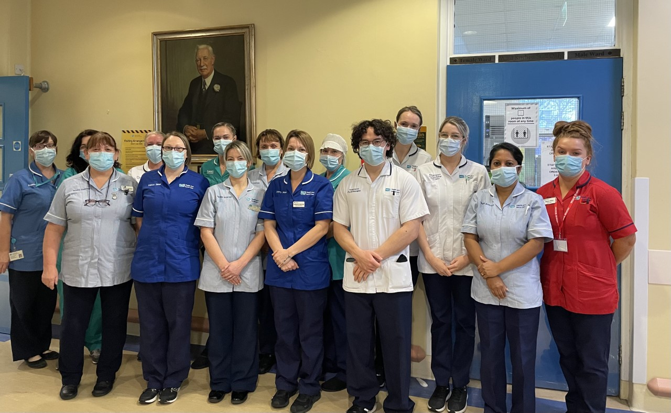

Slide 25

Thank-you
Spring at The Dark Hedges
Thank you for listening

